Slide 1
ANIMAL
INTRUSION DETECTION SYSTEM
SURESH KANNA P-18MIS1067

Slide 2
01
02
PROBLEM STATEMENT
ABSTRACT
03
NEWS COLLECTION
04
Table of Contents
MODULES & TOOLS
05
06
FLOW CHART
SIMILAR PROJECTS
07- CAMERA TRAPS

Slide 3
Problem Statement
With rapid increase in deforestation and depletion ecosystems animals are finding it hard to live in its natural habitat, there are numerous incidents that take place where animals come out of their enclosure in search of food.
These incidents almost always end up with the animals getting hurt due to the voluntary action by the humans or by the animals getting in the middle of a dangerous human activity.
So we came up with the idea of creating an animal intrusion detection using image processing as a solution.

Slide 4
Abstract
Our solution to the problem is to build a animal intrusion detection system that alerts the user of sightings of animals in real time if it has entered the village or locality. We plan to achieve this by training the model with Mask-RCNN algorithm. Which is fed animal photos with labeling.
This will enable the model to detect and recognize an animal. In this project we will be concentrating on a single specie of animal like elephant

Slide 5
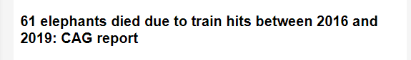
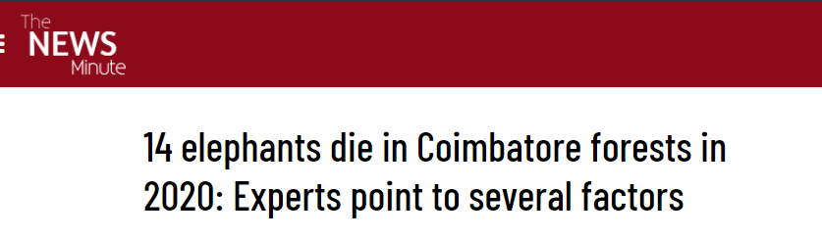
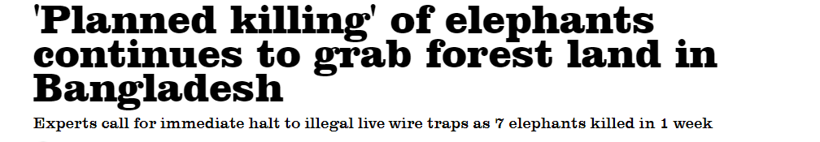
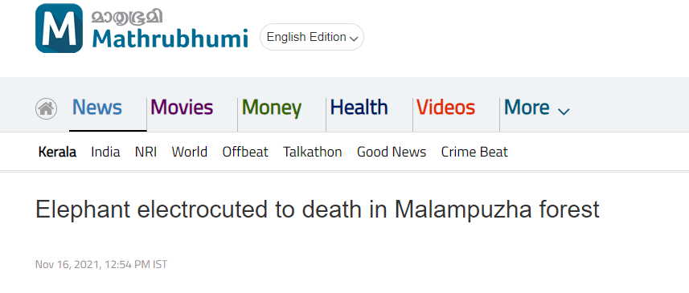

Slide 6
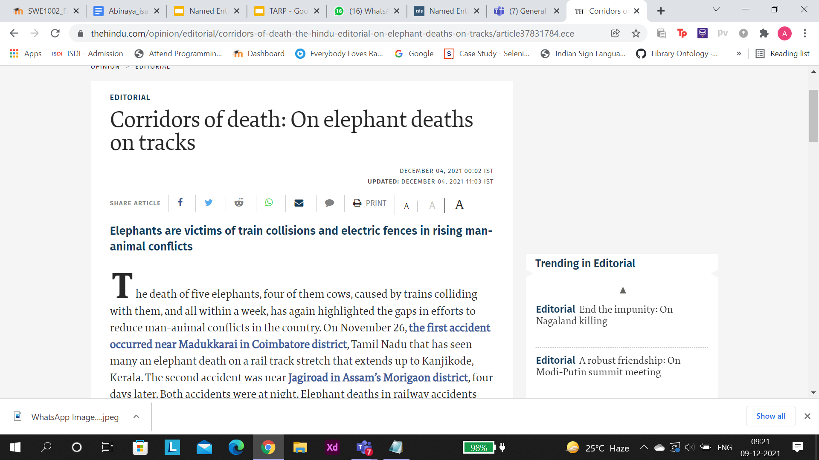
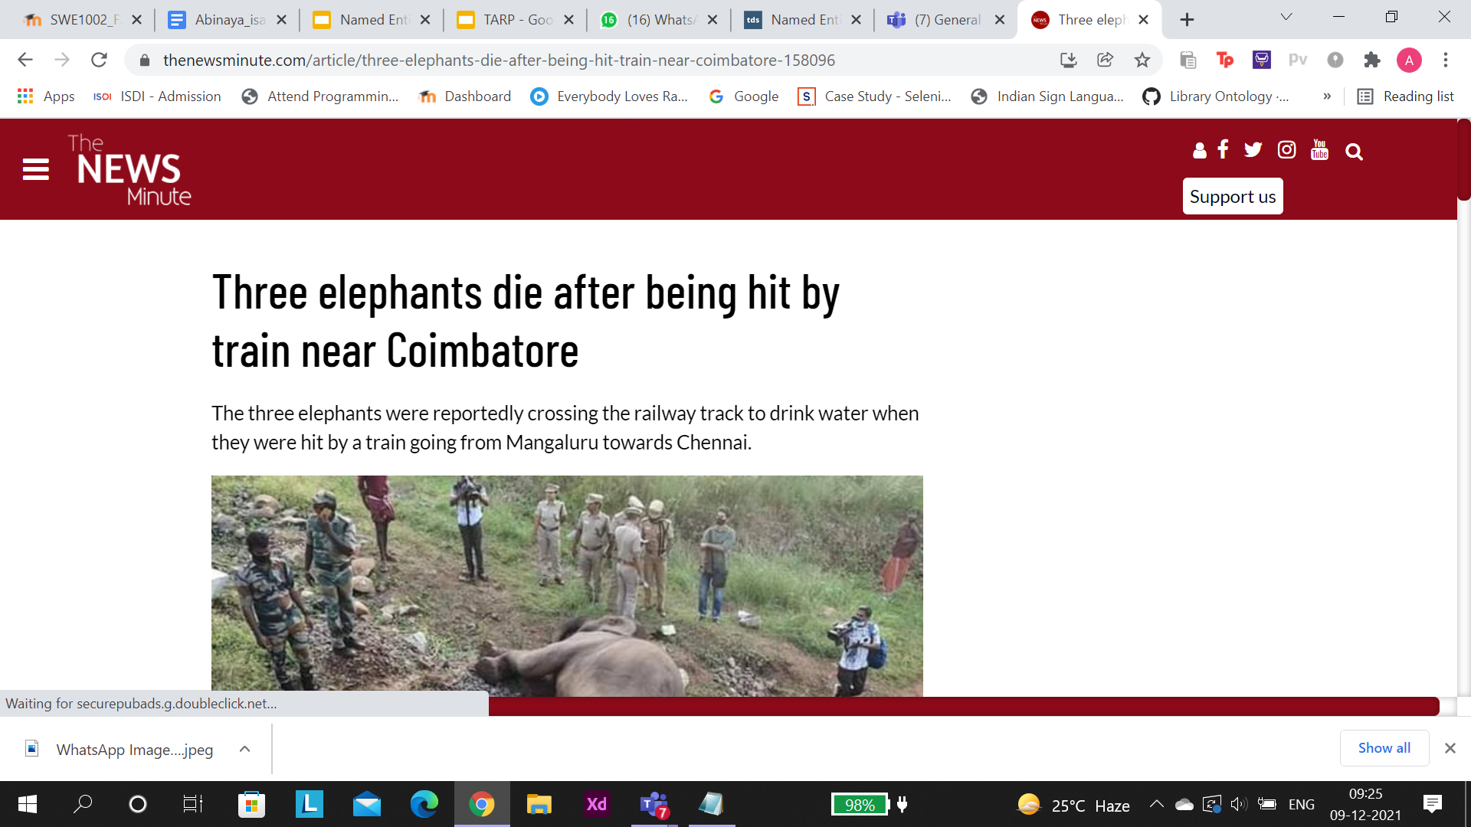
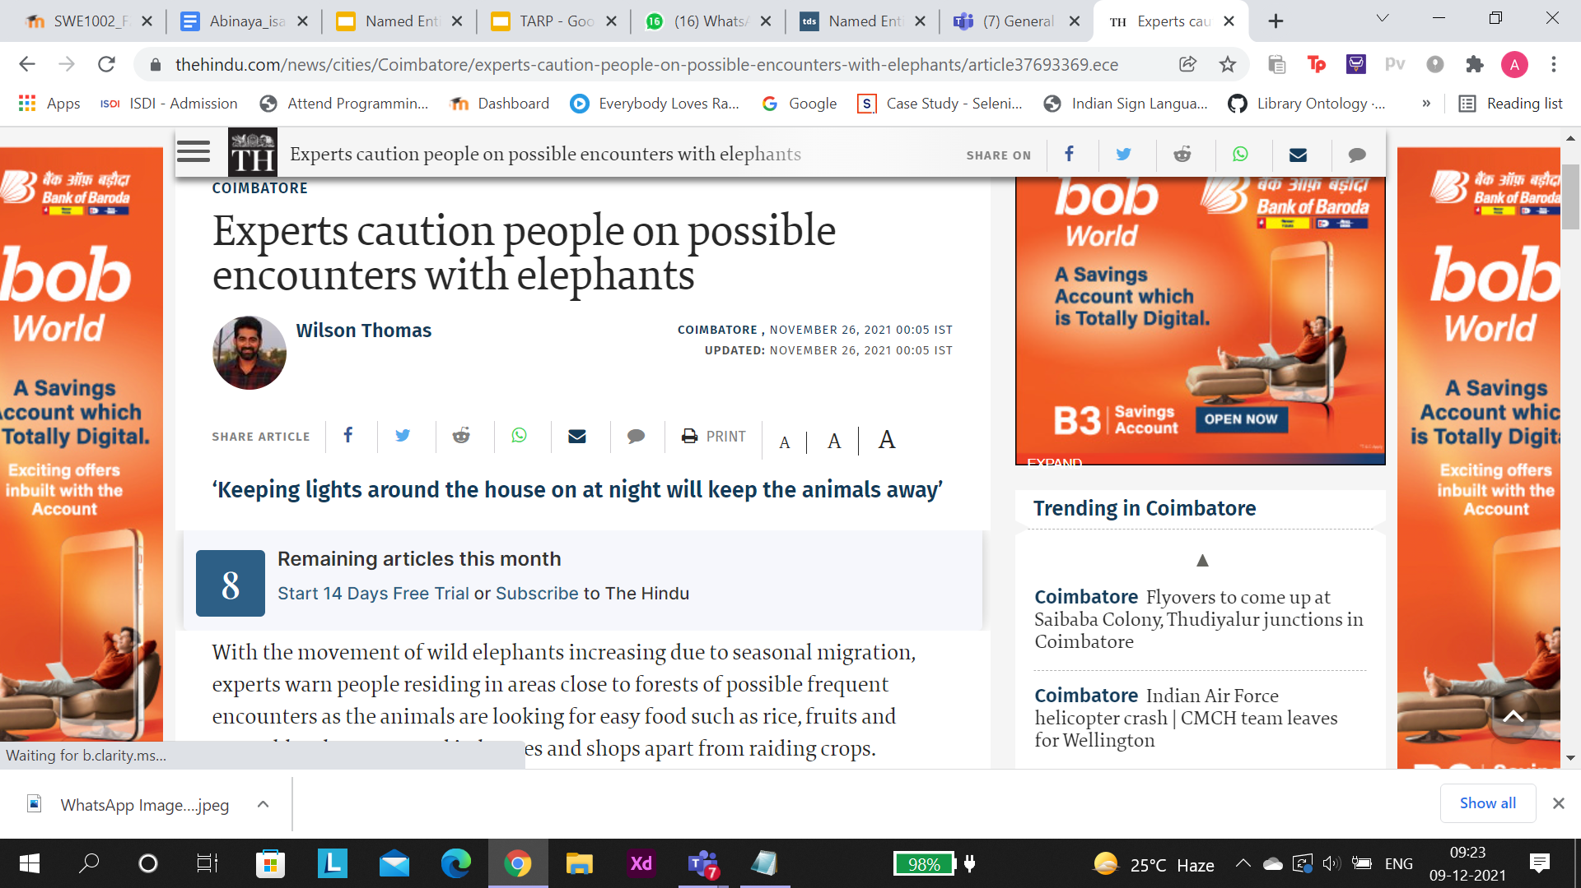

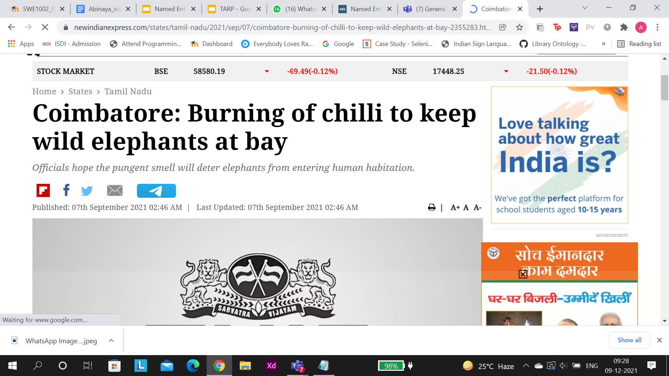

Slide 7
Tools Used
Python
Tkinter
Mask-RCNN

Slide 8
MODULES!
Object Detection/
Recognition
User interface
Alert

Slide 9
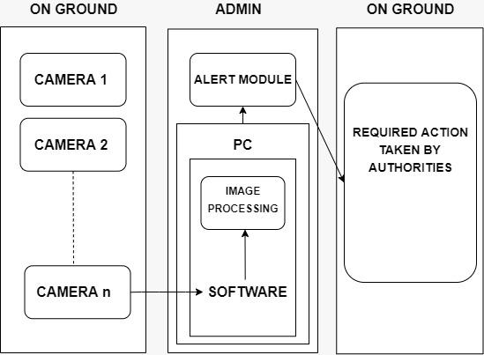
FlowChart

Slide 10
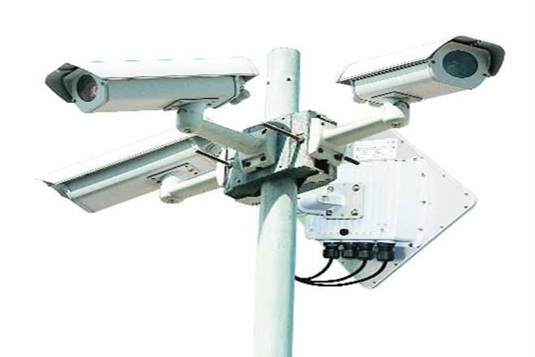
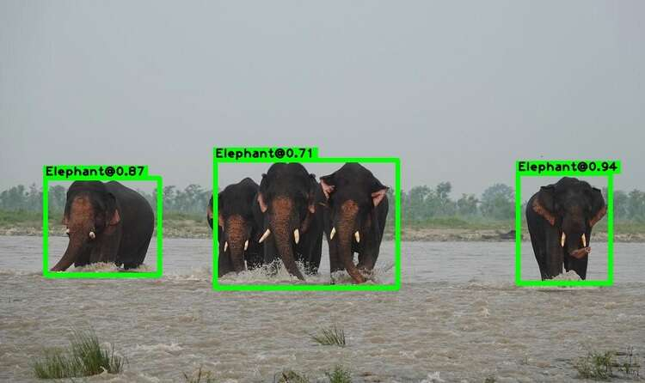
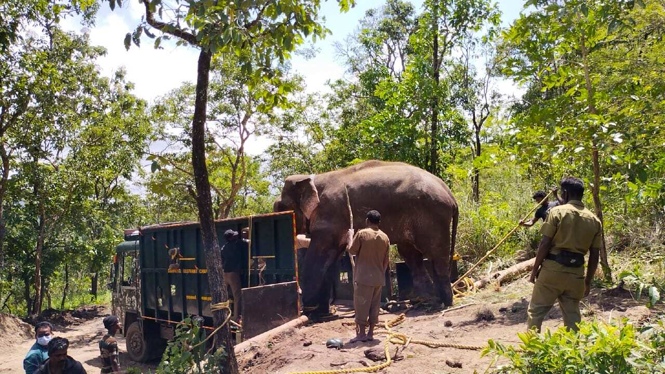

Slide 11
SIMILAR PROJECTS
Mark O. Afolabi, Idowu and A. Olalekan, “Design and Implementation of Farm Monitoring and Security System”, International Journal of Computer Applications (0975 – 8887) Volume 181 – No. 9, August 2018
S Jeevitha and Dr. Venkatesh Kumar, “A Review of Animal Intrusion Detection System”, International Journal of Engineering Research & Technology (IJERT) Vol. 9 Issue 05, May-2020.
3.Saieshwar Radhakrishnan, Ramanathan.R, “A Support Vector Machine with Gabor Features for Animal Intrusion Detection in Agriculture Fields”, 8th International Conference on Advances in Computing and Communication (ICACC-2018)

Slide 12
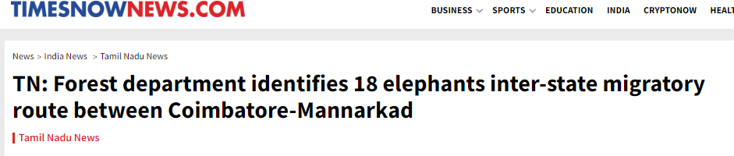
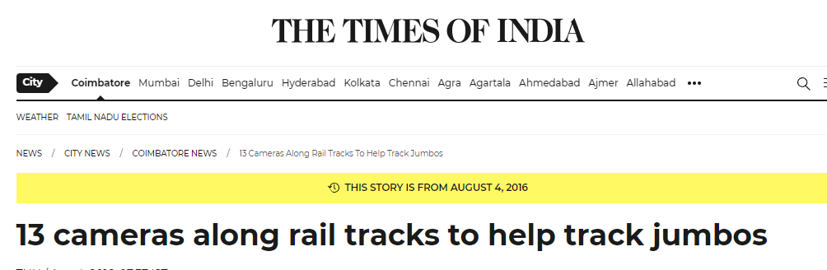
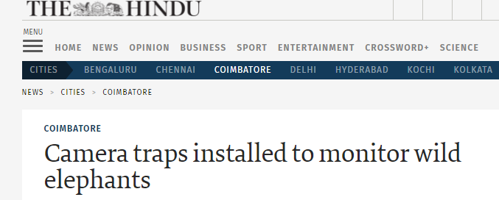
CAMERA TRAP!

Slide 13
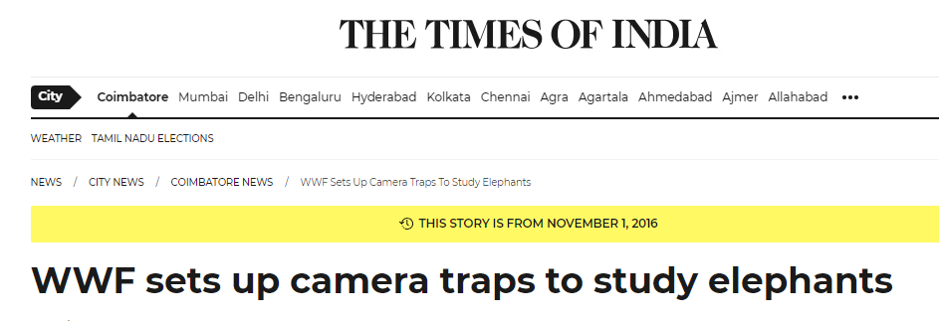
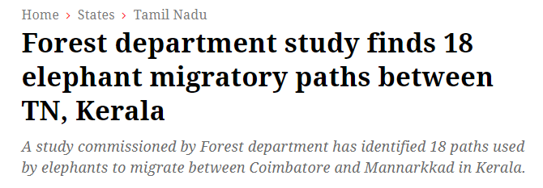

Slide 14
TRACKING!
The camera capturing the image over a 15-20-meter distance.
Multiple cameras should be placed.
Camera Placement strategy- forest department

Slide 15
THANK YOU!

